Slide 1
Project Based Learning and Other Teaching Techniques for Introductory Accounting Courses
Elizabeth A. Payne, PhD, CPA
epayne@bellarmine.edu

Slide 2
Our Game Plan Today
Project Based Learning Activities
Teaching Techniques
Additional Resources

Slide 3
PROJECT BASED LEARNING

Slide 4
PBL is “a systematic teaching method that engages students in learning knowledge and skills through an extended inquiry process structured around complex, authentic questions and carefully designed projects and tasks” (p. 4).
Markham, T., Larmer, J., & Ravitz, J. (2003). Project based learning handbook: A guide to standards-focused project based learning (2nd Ed.). Novato, CA: Buck Institute for Education.

Slide 5
PBL encourages reform-based constructivist practices whereby teachers shift from expert providers of knowledge to facilitators of learning
Savery, J. R., & Duffy, T. M. (1995). Problem based learning: An instructional model and its constructivist framework. Educational Technology, 35(5), 31–38.

Slide 6
PBL entails the construction of knowledge with multiple perspectives, within a social activity, and allows for self-awareness of learning and knowing while being context dependent
Duffy, T. M. & Cunningham, D. J. (1996). Constructivism: Implications for the design and delivery of instruction. In D. H. Jonassen (Ed), Handbook of research for educational communications and technology (pp. 170–98). New York: Macmillan.

Slide 7
Projects should be
  Central to the curriculum
  Focused on problems that drive the students to struggle with major concepts
  Involve the students in constructivist investigation
  Student-driven
  Realistic
Thomas, J. W. (2000). A review of PBL. Retrieved March 3, 2010, from http://www.bie.org/ research/study/review_of_project_based_learning_2000/

Slide 8
Advantages:
  Foster intrinsic motivation, and develop a range of abilities and skills
  Increases self-esteem and confidence
  Enhances critical thinking abilities, presentation skills and communication skills, and the ability to work effectively on a team
  Students move from novices to experts
  Students interpret the information rather than just report facts
  Increased motivation to work collaboratively
  More positive attitudes towards learning
Tamim, S. R. & Grant, M. M. (2013). Definitions and uses: Case study of teachers implementing project-based learning. The Interdisciplinary Journal of Problem-based Learning, 7 (2), 72-101.

Slide 9
PBL Activity #1: Learning the Accounting Equation, Balance Sheet, Income Statement and Statement of Cash Flows

Slide 10


Let’s open a lawn mowing business!

Slide 11
What events will take place as we open this business and begin to operate it?

Slide 12

How can we get money?
    Get a loan from the bank

Slide 13



What do we need to get started?
    Lawn mower, gasoline, oil, etc.
    Advertising to attract customers

Slide 14
What happens in the business on a daily basis?
    Mow lawns and collect fees
    Use some of our supplies of gas, oil, etc.
    May also have to pay for some necessary repairs

Slide 15
It has been a month now and we really like this!
Let’s expand the business!
Let’s ask the bank for MORE money.
What will the bank likely want to know before they will lend us more money?
    What did you do with the cash from the first loan?
    What do you currently own and currently owe?
    Is your business profitable so far?

Slide 16
The Accounting Equation

Slide 17
ASSETS
LIABILITIES
OWNERS’
EQUITY

Slide 18
Assets – resources with future benefits that are owned or controlled by a company
Liabilities – what a company owes its creditors in future payments, products or services
Owners’ Equity (or Capital) – owners’ claims on assets
  Also called Net Assets (Assets – Liabilities) or Residual Equity

Slide 19
Expanding the accounting equation:
  Equity has 2 parts
    (1) Contributed Capital – the amount owners (stockholders) have invested (Common Stock)
    (2) Retained Earnings – the amount of Net Income kept in the company
      Net Income = Revenues – Expenses
      Dividends
        Distributions of earnings to owners
        They decrease Retained Earnings

Slide 20
  Revenues – earnings from a company’s various earning-related activities
    e.g. services provided, sales of products, rent of facilities to others
    Increase retained earnings
  Expenses – the cost of assets or services used to earn revenues
    e.g. wages, use of supplies, advertising, utilities, etc.
    Decrease retained earnings

Slide 21
Assets = Liabilities + Equity
A = L + E (abbreviated)
A = L + (Contributed Capital + Retained Earnings)
A = L + (Contributed Capital + (Net Income – Dividends))
A = L + (Contributed Capital + (Revenues – Expenses) – Dividends))

Slide 22
So lets go back through the events of our lawn mowing business and identify which elements of the accounting equation are involved.

Slide 23
Get a loan from the bank
 | Assets | = | Liabilities | + | Contributed Capital | + | Revenue | - | Expenses | - | Dividends
1 | X |  | X

Slide 24
Purchase a lawn mower, gasoline, oil, etc.
 | Assets | = | Liabilities | + | Contributed Capital | + | Revenue | - | Expenses | - | Dividends
1 | X |  | X
2 | X

Slide 25
Pay for advertising to attract customers
 | Assets | = | Liabilities | + | Contributed Capital | + | Revenue | - | Expenses | - | Dividends
1 | X |  | X
2 | X
3 | X |  |  |  |  |  |  |  | X

Slide 26
Mow lawns and collect fees
 | Assets | = | Liabilities | + | Contributed Capital | + | Revenue | - | Expenses | - | Dividends
1 | X |  | X
2 | X
3 | X |  |  |  |  |  |  |  | X
4 | X |  |  |  |  |  | X

Slide 27
Use some of our supplies of gas, oil, etc.
 | Assets | = | Liabilities | + | Contributed Capital | + | Revenue | - | Expenses | - | Dividends
1 | X |  | X
2 | X
3 | X |  |  |  |  |  |  |  | X
4 | X |  |  |  |  |  | X
5 | X |  |  |  |  |  |  |  | X

Slide 28
May also have to pay for some necessary repairs
 | Assets | = | Liabilities | + | Contributed Capital | + | Revenue | - | Expenses | - | Dividends
1 | X |  | X
2 | X
3 | X |  |  |  |  |  |  |  | X
4 | X |  |  |  |  |  | X
5 | X |  |  |  |  |  |  |  | X
6 | X |  |  |  |  |  |  |  | X

Slide 29
Assume the following:
  We initially borrowed $1,000 from the bank
  The lawn mower cost $500
  Our supplies cost $300
  We spent $100 on advertising
  We mowed 15 lawns for a fee of $25 per lawn
  We used ½ of our supplies during April
  We had to repair the lawn mower once and that cost $75
Record the events in a table like before. Total up each column and make sure the accounting equation is in balance.

Slide 30
Get a loan from the bank
 | Assets | = | Liabilities | + | Contributed Capital | + | Revenue | - | Expenses | - | Dividends
1 | 1,000 |  | 1,000
2
3
4
5
6
TOTALS

Slide 31
Purchase a lawn mower, gasoline, oil, etc.
 | Assets | = | Liabilities | + | Contributed Capital | + | Revenue | - | Expenses | - | Dividends
1 | 1,000 |  | 1,000
2 | 500
 | 300
 | -800
3
4
5
6
TOTALS

Slide 32
Pay for advertising to attract customers
 | Assets | = | Liabilities | + | Contributed Capital | + | Revenue | - | Expenses | - | Dividends
1 | 1,000 |  | 1,000
2 | 500
 | 300
 | -800
3 | -100 |  |  |  |  |  |  |  | 100
4
5
6
TOTALS

Slide 33
Mow lawns and collect fees
 | Assets | = | Liabilities | + | Contributed Capital | + | Revenue | - | Expenses | - | Dividends
1 | 1,000 |  | 1,000
2 | 500
 | 300
 | -800
3 | -100 |  |  |  |  |  |  |  | 100
4 | 375 |  |  |  |  |  | 375
5
6
TOTALS

Slide 34
Use some of our supplies of gas, oil, etc.
 | Assets | = | Liabilities | + | Contributed Capital | + | Revenue | - | Expenses | - | Dividends
1 | 1,000 |  | 1,000
2 | 500
 | 300
 | -800
3 | -100 |  |  |  |  |  |  |  | 100
4 | 375 |  |  |  |  |  | 375
5 | -150 |  |  |  |  |  |  |  | 150
6
TOTALS

Slide 35
May also have to pay for some necessary repairs
 | Assets | = | Liabilities | + | Contributed Capital | + | Revenue | - | Expenses | - | Dividends
1 | 1,000 |  | 1,000
2 | 500
 | 300
 | -800
3 | -100 |  |  |  |  |  |  |  | 100
4 | 375 |  |  |  |  |  | 375
5 | -150 |  |  |  |  |  |  |  | 150
6 | -75 |  |  |  |  |  |  |  | 75
TOTALS

Slide 36
 | Assets | = | Liabilities | + | Contributed Capital | + | Revenue | - | Expenses | - | Dividends
1 | 1,000 |  | 1,000
2 | 500
 | 300
 | -800
3 | -100 |  |  |  |  |  |  |  | 100
4 | 375 |  |  |  |  |  | 375
5 | -150 |  |  |  |  |  |  |  | 150
6 | -75 |  |  |  |  |  |  |  | 75
TOTALS | 1,050 |  | 1,000 |  |  |  | 375 |  | 325

Slide 37
Financial Statements

Slide 38
Income Statement
  Describes the company’s revenues and expenses
  Format: Revenues – Expenses = Net Income (or Net Loss)
  Covers a period of time such as a month, quarter or year

Slide 39
Balance Sheet
  Describes a company’s financial position
  Format: Assets = Liabilities + Equity
  Is prepared as of one day in time (e.g. 12/31/20XX)

Slide 40
Statement of Cash Flows
  Identifies cash inflows and cash outflows
  Shows activities as operating, investing and financing
  Covers a period of time such as a month, quarter or year

Slide 41
Awesome Lawn Service Company
Income Statement
For the month of April, 20xx
Revenues:
 | Fees from mowing lawns |  | $ 375
Expenses:
 | Advertising | $ 100
 | Supplies | 150
 | Repairs | 75
 | Total Expenses |  | $ 325
Net Income |  |  | $ 50

Slide 42
Awesome Lawn Service Company
Balance Sheet
As Of April 30, 20xx
Assets:
 | Cash | $ 400
 | Supplies | 150
 | Lawn Mower | 500
TOTAL ASSETS |  |  |  | $ 1,050
Liabilities:
 | Bank Loan | $ 1,000
Total Liabilities |  |  | $ 1,000
Owners' Equity:
 | Contributed Capital | -
 | Retained Earnings | 50
Total Owners' Equity |  |  | 50
LIABILITIES AND OWNERS' EQUITY |  |  |  | $ 1,050

Slide 43
Awesome Lawn Service Company
Statement of Cash Flows
For the month of April, 20xx
Cash from Operating Activities:
 | Fees from mowing lawns |  | $375
 | Advertising Paid |  | -100
 | Repairs Paid |  | -75
 | Total |  |  | $200
Cash from Investing Activities:
 | Paid for lawn mower |  | -$500
 | Paid for supplies |  | -300
 | Total |  |  | -$800
Cash from Financing Activities:
 | Borrowed from the bank |  |  | $1,000
Total from all activities |  |  |  | $400
Add: Beginning Cash Balance |  |  |  | 0
Ending Cash Balance |  |  |  | $400

Slide 44
PBL Activity #2: Understanding Inventory Costing Methods

Slide 45
Consider the following events and move your M&Ms as appropriate (place them in a purchased pile or a sold pile)
1. Purchase 10 orange
2. Purchase 8 red
3. Purchase 7 yellow
4. Sell 3 orange
5. Sell 6 red
6. Purchase 10 green
7. Purchase 15 red
8. Purchase 12 yellow
9. Sell 15 yellow
10. Sell 5 green
11. Purchase 9 orange
12. Sell 5 red
13. Purchase 6 green
14. Sell 8 orange
15. Purchase 5 yellow

Slide 46
PART A:
Calculate how much inventory (# of items and the total $ amount) there is left.
Calculate how much inventory (# of items and the total $ amount) was sold.

Slide 47
Inventory Left
Inventory Sold
 |  |  | Total
 | # | Cost | (# x Cost)
Red | 12 | 1.00 | $ 12.00
Orange | 8 | 1.50 | $ 12.00
Yellow | 9 | 1.75 | $ 15.75
Green | 11 | 2.00 | $ 22.00
TOTALS | 40 |  | $ 61.75
 |  | Total
# | Cost | (# x Cost)
11 | 1.00 | $ 11.00
11 | 1.50 | $ 16.50
15 | 1.75 | $ 26.25
5 | 2.00 | $ 10.00
42 |  | $ 63.75

Slide 48
PART B:
Now, assume new inventory purchases are placed on the shelves behind any existing items and when customers buy the items they MUST take the inventory in the front, regardless of color (go back to the beginning and everywhere it says “sell”, mark out the color).
  Calculate how much inventory (# of items and the total $ amount) there is left.
  Calculate how much inventory (# of items and the total $ amount) was sold.

Slide 49
Inventory Left
Inventory Sold
 |  |  | Total
 | # | Cost | (# x Cost)
Red | 8 | 1.00 | $ 8.00
Orange | 9 | 1.50 | $ 13.50
Yellow | 17 | 1.75 | $ 29.75
Green | 6 | 2.00 | $ 12.00
TOTALS | 40 |  | $ 63.25
 |  | Total
# | Cost | (# x Cost)
15 | 1.00 | $ 15.00
10 | 1.50 | $ 15.00
7 | 1.75 | $ 12.25
10 | 2.00 | $ 20.00
42 |  | $ 62.25

Slide 50
PART C:
Assume new inventory purchases are placed in front of older items on the shelves and when customers buy the items they MUST take the inventory from the front, regardless of the color.
  Calculate how much inventory (# of items and the total $ amount) there is left.
  Calculate how much inventory (# of items and the total $ amount) was sold.

Slide 51
PART C:
Inventory Left
Inventory Sold
 |  |  | Total
 | # | Cost | (# x Cost)
Red | 13 | 1.00 | $ 13.00
Orange | 12 | 1.50 | $ 18.00
Yellow | 5 | 1.75 | $ 8.75
Green | 10 | 2.00 | $ 20.00
TOTALS | 40 |  | $ 59.75
 |  | Total
# | Cost | (# x Cost)
10 | 1.00 | $ 10.00
7 | 1.50 | $ 10.50
19 | 1.75 | $ 33.25
6 | 2.00 | $ 12.00
42 |  | $ 65.75

Slide 52
INVENTORY COST FLOW ASSUMPTIONS

Slide 53
The cost at which a business purchases its inventory will likely change during the accounting period
If the business has a very small quantity of inventory (typically high-priced), the Specific-Identification Method of costing may be used
  Inventory items must be able to be specifically identified through the use of serial numbers, VIN numbers, etc.
  When an item is sold, its specific cost is transferred out of Inventory and into COGS
    Does a perfect job of matching expense with revenue

Slide 54
For most businesses, however, this is not practical so companies use one of the three cost-flow assumption methods (FIFO, LIFO, Weighted-Average)
  These methods assume that costs flow a particular way; the actual physical flow of goods may or may not be the same as the assumption

Slide 55
FIFO (First-In, First-Out) assumes that the earliest inventory items are sold first (this reflects the actual physical flow for many businesses)
  Ending Inventory is made up of the most recent purchases so it most accurately reflects current cost
  COGS is made up of older costs; when matched to current sales “phantom profits” may result (profits overstated)
LIFO (Last-In, First-Out) assumes that the most recently purchased items are sold first
  Ending Inventory is made up of the older costs so it does not reflect the current cost of the inventory
  COGS is made up of very recent costs so when matched to current sales, profits are very realistic

Slide 56
SPECIFIC IDENTIFICATION
 | Inventory Left |  |  |  | Inventory Sold
 |  |  | Total |  |  |  | Total
 | # | Cost | (# x Cost) |  | # | Cost | (# x Cost)
Red | 12 | 1.00 | $ 12.00 |  | 11 | 1.00 | $ 11.00
Orange | 8 | 1.50 | $ 12.00 |  | 11 | 1.50 | $ 16.50
Yellow | 9 | 1.75 | $ 15.75 |  | 15 | 1.75 | $ 26.25
Green | 11 | 2.00 | $ 22.00 |  | 5 | 2.00 | $ 10.00
TOTALS | 40 |  | $ 61.75 |  | 42 |  | $ 63.75
FIFO
 | Inventory Left |  |  |  | Inventory Sold
 |  |  | Total |  |  |  | Total
 | # | Cost | (# x Cost) |  | # | Cost | (# x Cost)
Red | 8 | 1.00 | $ 8.00 |  | 15 | 1.00 | $ 15.00
Orange | 9 | 1.50 | $ 13.50 |  | 10 | 1.50 | $ 15.00
Yellow | 17 | 1.75 | $ 29.75 |  | 7 | 1.75 | $ 12.25
Green | 6 | 2.00 | $ 12.00 |  | 10 | 2.00 | $ 20.00
TOTALS | 40 |  | $ 63.25 |  | 42 |  | $ 62.25
LIFO
 | Inventory Left |  |  |  | Inventory Sold
 |  |  | Total |  |  |  | Total
 | # | Cost | (# x Cost) |  | # | Cost | (# x Cost)
Red | 13 | 1.00 | $ 13.00 |  | 10 | 1.00 | $ 10.00
Orange | 12 | 1.50 | $ 18.00 |  | 7 | 1.50 | $ 10.50
Yellow | 5 | 1.75 | $ 8.75 |  | 19 | 1.75 | $ 33.25
Green | 10 | 2.00 | $ 20.00 |  | 6 | 2.00 | $ 12.00
TOTALS | 40 |  | $ 59.75 |  | 42 |  | $ 65.75

Slide 57
PBL Activity #3: Understanding Depreciation Methods

Slide 58
Assume a company buys an asset that is expected to last 5 years.
Use your 100 M&Ms to show how much of the asset is used up in each of the 5 years if:
  It is used up evenly
  It is used up ½ in the first year, ¼ in the second year, 1/8 in the third year, 1/16 in the fourth year
  It will be used up based on how much it is actually used to produce inventory. It will produce 120 units over its life. Units produced are as follows:
    Year 1 = 15
    Year 2 = 25
    Year 3 = 20
    Year 4 = 40
    Year 5 = 20
Assume this asset cost $225,000 and complete the tables for each of the 3 scenarios above.

Slide 59
Scenario #1
Year | $ Amount Used Up This Year | Total $ Amount Used Up for All Years to Date | $ Amount Left to be Used in Future Years
1 | $ 45,000 | $ 45,000 | $ 180,000
2 | $ 45,000 | $ 90,000 | $ 135,000
3 | $ 45,000 | $ 135,000 | $ 90,000
4 | $ 45,000 | $ 180,000 | $ 45,000
5 | $ 45,000 | $ 225,000 | $ -

Slide 60
Scenario #2
Year | $ Amount Used Up This Year | Total $ Amount Used Up for All Years to Date | $ Amount Left to be Used in Future Years
1 | $ 112,500 | $ 112,500 | $ 112,500
2 | $ 56,250 | $ 168,750 | $ 56,250
3 | $ 28,125 | $ 196,875 | $ 28,125
4 | $ 14,063 | $ 210,938 | $ 14,063
5 | $ 7,031 | $ 217,969 | $ 7,031

Slide 61
Scenario #3
Year | $ Amount Used Up This Year | Total $ Amount Used Up for All Years to Date | $ Amount Left to be Used in Future Years
1 | $ 28,125 | $ 28,125 | $ 196,875
2 | $ 46,875 | $ 75,000 | $ 150,000
3 | $ 37,500 | $ 112,500 | $ 112,500
4 | $ 75,000 | $ 187,500 | $ 37,500
5 | $ 37,500 | $ 225,000 | $ -

Slide 62
Depreciation
Depreciation is the process of allocating the cost of a plant asset to expense in the accounting periods benefiting from its use
  Does not measure a decline in market value
  Does not measure physical deterioration
  Depreciation is only recorded when the asset is actually in service
Accumulated Depreciation is the total amount of depreciation taken on the asset to date
Book Value = Cost – Accumulated Deprecation
  Accumulated Depreciation is a contra asset

Slide 63
Depreciation Methods
(1) Straight Line Method
  Most frequently used
  Charges the same amount of expense to each full accounting period of the asset’s useful life
(2) Declining-Balance Method is an accelerated method
  Accelerated depreciation methods produce larger depreciation expenses in the early years of an asset’s life and less in later years
(3) Units-of-Production Method
  Does a better job of matching depreciation expense with revenues when asset usage varies from period to period (depreciation expense depends on output)

Slide 64
PBL Activity #4: Time Value of Money

Slide 65
Scenario #1
 | Amount Invested | Annual Interest Earned | End of Year Balance
Beginning of Year 1 | 100.00 | 5.00 | 105.00
Beginning of Year 2 | 0.00 | 5.25 | 110.25
Beginning of Year 3 | 0.00 | 5.51 | 115.76
Beginning of Year 4 | 0.00 | 5.79 | 121.55
Beginning of Year 5 | 0.00 | 6.08 | 127.63
Your favorite aunt gives you $100 for your birthday. You put it in a bank account that earns 5% interest annually.
Use the chart to determine how much money you will have at the end of 5 years. Round your calculations to 2 decimal points.

Slide 66
Scenario #2
Now assume your favorite aunt gives you $100 on your birthday every year, for five years. Each year you deposit the new money into the same bank account that earns 5% interest annually.
Use the chart to determine how much money you will have at the end of 5 years. Round your calculations to 2 decimal points.
 | Amount Invested | New Beginning Year Balance (see * below) | Annual Interest Earned | End of Year Balance
Beginning of Year 1 | $100 | $100 | $5.00 | $105
Beginning of Year 2 | $100 | $205 | $10.25 | $215
Beginning of Year 3 | $100 | $315 | $15.76 | $331
Beginning of Year 4 | $100 | $431 | $21.55 | $453
Beginning of Year 5 | $100 | $553 | $27.63 | $580
*Last year's ending balance + amount invested at beginning of current year

Slide 67
Time Value of Money
The TIME VALUE OF MONEY concept recognizes that an amount of cash to be received today is worth more than the same amount of cash to be received in the future
Future Value (FV) is a formula used to calculate the value of a cash flow at a later date than originally received
Present Value (PV) is a formula used to calculate the present day value of an amount that is received at a future date.
A stream of payments is called an Annuity

Slide 68
$100 x 1.27628 = $127.63

Slide 69
$100 x 5.8019 = $580.19

Slide 70
$127.63 x .78353 = $100.01

Slide 71
Other Teaching Techniques

Slide 72
Memorization
Not always a bad thing!!!!!
We must first commit new information to memory before we can integrate it with our existing knowledge
We must also commit procedures to memory before they can become automatic
Discuss these concepts with students
Use a video
https://www.youtube.com/watch?v=bSycdIx-C48&list=PL8dPuuaLjXtOPRKzVLY0jJY-uHOH9KVU6&index=13

Slide 73
Memorizing Steps in Journalizing
Identify the accounts affected by the transaction
  Double-entry accounting requires that each transaction affect, and be recorded in, at least two accounts (can be more than 2)
Identify the type of each account in the transaction (e.g. asset, liability, stockholders’ equity, revenue, expense, dividend) and
Whether it is increasing or decreasing
  Make sure the transaction, as you understand it, keeps the accounting equation in balance

Slide 74
4. Journalize Transactions
Prepare a journal entry based on the rules of debits and credits
    Debits and credits must equal in the journal entry
Normal Balance Increase Decrease
Assets D D C
Liabilities C C D
Owners’ Equity C C D
Revenues C C D
Expenses D D C
Dividends D D C
This must be memorized too!

Slide 75
Normal Balance Increase Decrease
Assets D D C
Liabilities C C D
Owners’ Equity C C D
Revenues C C D
Expenses D D C
Dividends D D C
Example: Purchase supplies for cash
Accounts Affected
Type
Increasing or Decreasing
Debit or Credit
J/E:

Slide 76
Normal Balance Increase Decrease
Assets D D C
Liabilities C C D
Owners’ Equity C C D
Revenues C C D
Expenses D D C
Dividends D D C
Example: Purchase supplies for cash
Accounts Affected | Supplies | Cash
Type
Increasing or Decreasing
Debit or Credit
J/E:

Slide 77
Normal Balance Increase Decrease
Assets D D C
Liabilities C C D
Owners’ Equity C C D
Revenues C C D
Expenses D D C
Dividends D D C
Example: Purchase supplies for cash
Accounts Affected | Supplies | Cash
Type | Asset | Asset
Increasing or Decreasing
Debit or Credit
J/E:

Slide 78
Normal Balance Increase Decrease
Assets D D C
Liabilities C C D
Owners’ Equity C C D
Revenues C C D
Expenses D D C
Dividends D D C
Example: Purchase supplies for cash
Accounts Affected | Supplies | Cash
Type | Asset | Asset
Increasing or Decreasing | Increasing | Decreasing
Debit or Credit
J/E:

Slide 79
Normal Balance Increase Decrease
Assets D D C
Liabilities C C D
Owners’ Equity C C D
Revenues C C D
Expenses D D C
Dividends D D C
Example: Purchase supplies for cash
Accounts Affected | Supplies | Cash
Type | Asset | Asset
Increasing or Decreasing | Increasing | Decreasing
Debit or Credit | Debit | Credit
J/E:

Slide 80
Normal Balance Increase Decrease
Assets D D C
Liabilities C C D
Owners’ Equity C C D
Revenues C C D
Expenses D D C
Dividends D D C
Example: Purchase supplies for cash
Accounts Affected | Supplies | Cash
Type | Asset | Asset
Increasing or Decreasing | Increasing | Decreasing
Debit or Credit | Debit | Credit
J/E: Supplies $XX Cash $XX

Slide 81
Normal Balance Increase Decrease
Assets D D C
Liabilities C C D
Owners’ Equity C C D
Revenues C C D
Expenses D D C
Dividends D D C
Example: Receive fees for providing services
Accounts Affected
Type
Increasing or Decreasing
Debit or Credit
J/E:

Slide 82
Normal Balance Increase Decrease
Assets D D C
Liabilities C C D
Owners’ Equity C C D
Revenues C C D
Expenses D D C
Dividends D D C
Example: Receive fees for providing services
Accounts Affected | Cash | Service Revenue
Type
Increasing or Decreasing
Debit or Credit
J/E:

Slide 83
Normal Balance Increase Decrease
Assets D D C
Liabilities C C D
Owners’ Equity C C D
Revenues C C D
Expenses D D C
Dividends D D C
Example: Receive fees for providing services
Accounts Affected | Cash | Service Revenue
Type | Asset | Revenue
Increasing or Decreasing
Debit or Credit
J/E:

Slide 84
Normal Balance Increase Decrease
Assets D D C
Liabilities C C D
Owners’ Equity C C D
Revenues C C D
Expenses D D C
Dividends D D C
Example: Receive fees for providing services
Accounts Affected | Cash | Service Revenue
Type | Asset | Revenue
Increasing or Decreasing | Increasing | Increasing
Debit or Credit
J/E:

Slide 85
Normal Balance Increase Decrease
Assets D D C
Liabilities C C D
Owners’ Equity C C D
Revenues C C D
Expenses D D C
Dividends D D C
Example: Receive fees for providing services
Accounts Affected | Cash | Service Revenue
Type | Asset | Revenue
Increasing or Decreasing | Increasing | Increasing
Debit or Credit | Debit | Credit
J/E:

Slide 86
Normal Balance Increase Decrease
Assets D D C
Liabilities C C D
Owners’ Equity C C D
Revenues C C D
Expenses D D C
Dividends D D C
Example: Receive fees for providing services
Accounts Affected | Cash | Service Revenue
Type | Asset | Revenue
Increasing or Decreasing | Increasing | Increasing
Debit or Credit | Debit | Credit
J/E: Cash $XX Service Revenue $XX

Slide 87
Memorizing Steps in Preparing a Statement of Cash Flows

Slide 88
PREPARING THE STATEMENT OF CASH FLOWS USING THE INDIRECT METHOD
What you need:
  Comparative balance sheet
  Current income statement
  Additional information found in specific general ledger accounts (will be provided to you in homework problems)

Slide 89
Step 1: Compute the change in each balance sheet account
Step 2: Set up the basic format for the statement
Step 3: In the Operating Section, enter net income (loss)
Step 4: Add back any noncash expenses (depreciation, amortization)
Step 5: Place the changes in each current asset and current liability account in the Operating Section

Slide 90
Step 6: Prepare the Investing Section (changes in long-term asset accounts except for current period depreciation)
Step 7: Prepare the Financing Section (changes in long-term debt and stockholders’ equity accounts including payment of dividends)
Step 8: Reconcile beginning and ending “Cash and Cash Equivalents”

Slide 91
Other important points:
  Assets have an negative relationship with cash (increase in an asset decreases cash)
  Liabilities and equity have a positive relationship with cash (increase in a liability increases cash)
  When assets are sold at a gain or loss, the gain is subtracted from net income in the Operating Section (a loss is added), and the cash proceeds are reported in the Investing Section

Slide 92
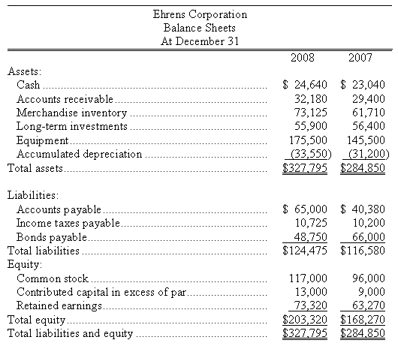
Step 1: Compute the change in each balance sheet account
1,600
2,780
11,415
(500)
30,000
2,350
24,620
525
(17,250)
21,000
4,000
10,050

Slide 93
Step 2: Set up the basic format for the statement
Cash flows from operating activities:
Cash Flows From Investing Activities:
Cash Flows From Financing Activities:

Slide 94
Step 3: In the Operating Section, enter net income (loss)
Cash flows from operating activities:
Net Income | 43,650
Cash Flows From Investing Activities:
Cash Flows From Financing Activities:

Slide 95
Step 4: Add back any noncash expenses (depreciation, amortization)
Cash flows from operating activities:
Net Income | 43,650
Adjustments to reconcile net income to net cash provided by operating activities:
Depreciation Expense | 29,400
Loss on Sale of Equipment | 8,400
Cash Flows From Investing Activities:
Cash Flows From Financing Activities:

Slide 96
Step 5: Place the changes in each current asset and current liability account in the Operating Section
Cash flows from operating activities:
Net Income | 43,650
Adjustments to reconcile net income to net cash provided by operating activities:
Depreciation Expense | 29,400
Loss on Sale of Equipment | 8,400
Increase in Accounts Receivable | (2,780)
Increase in Inventories | (11,415)
Increase in Accounts Payable | 24,620
Increase in Income Taxes Payable | 525
Net Cash Provided by Operations |  | 92,400
Cash Flows From Investing Activities:
Cash Flows From Financing Activities:

Slide 97
Step 6: Prepare the Investing Section (changes in long-term asset accounts except for current period depreciation)
Cash flows from operating activities:
Net Income | 43,650
Adjustments to reconcile net income to net cash provided by operating activities:
Depreciation Expense | 29,400
Loss on Sale of Equipment | 8,400
Increase in Accounts Receivable | (2,780)
Increase in Inventories | (11,415)
Increase in Accounts Payable | 24,620
Increase in Income Taxes Payable | 525
Net Cash Provided by Operations |  | 92,400
Cash Flows From Investing Activities:
Cash Received from Sales of LT Investments | 500
Cash Received from Sale of Equipment | 2,100
Cash Paid for Purchase of Equipment | (67,550)
Net Cash Used by Investing Activities |  | (64,950)
Cash Flows From Financing Activities:

Slide 98
Step 7: Prepare the Financing Section (changes in long-term debt and stockholders’ equity accounts including payment of dividends)
Cash flows from operating activities:
Net Income | 43,650
Adjustments to reconcile net income to net cash provided by operating activities:
Depreciation Expense | 29,400
Loss on Sale of Equipment | 8,400
Increase in Accounts Receivable | (2,780)
Increase in Inventories | (11,415)
Increase in Accounts Payable | 24,620
Increase in Income Taxes Payable | 525
Net Cash Provided by Operations |  | 92,400
Cash Flows From Investing Activities:
Cash Received from Sales of LT Investments | 500
Cash Received from Sale of Equipment | 2,100
Cash Paid for Purchase of Equipment | (67,550)
Net Cash Used by Investing Activities |  | (64,950)
Cash Flows From Financing Activities:
Cash Received from Stock Issuance | 25,000
Cash Paid for Retirement of Bonds | (17,250)
Cash Paid for Dividends | (33,600)
Net Cash Used by Financing Activities |  | (25,850)

Slide 99
Step 8: Reconcile beginning and ending “Cash and Cash Equivalents”
Cash flows from operating activities:
Net Income | 43,650
Adjustments to reconcile net income to net cash provided by operating activities:
Depreciation Expense | 29,400
Loss on Sale of Equipment | 8,400
Increase in Accounts Receivable | (2,780)
Increase in Inventories | (11,415)
Increase in Accounts Payable | 24,620
Increase in Income Taxes Payable | 525
Net Cash Provided by Operations |  | 92,400
Cash Flows From Investing Activities:
Cash Received from Sales of LT Investments | 500
Cash Received from Sale of Equipment | 2,100
Cash Paid for Purchase of Equipment | (67,550)
Net Cash Used by Investing Activities |  | (64,950)
Cash Flows From Financing Activities:
Cash Received from Stock Issuance | 25,000
Cash Paid for Retirement of Bonds | (17,250)
Cash Paid for Cash Dividends | (33,600)
Net Cash Used by Financing Activities |  | (25,850)
Net Increase in Cash |  | 1,600
Cash Balance at Beginning of Year |  | 23,040
Cash Balance at End of Year |  | 24,640

Slide 100
Additional Resources

Slide 101
Center for Audit Quality
http://www.thecaq.org/
http://www.thecaq.org/financial-statement-audit
http://www.thecaq.org/system-investor-protection
http://www.thecaq.org/fighting-fraud
http://www.thecaq.org/what-expect-when-you-choose-career-auditing

Slide 102
KPMG University Connection
https://www.kpmguniversityconnection.com/
Financial accounting videos
  https://www.kpmguniversityconnection.com/University/view/curriculum/?module_id=41
  https://www.kpmguniversityconnection.com/University/view/curriculum/?module_id=41
  https://www.kpmguniversityconnection.com/University/view/curriculum/?module_id=43
Ethical dilemmas

Slide 103
AICPA
https://www.startheregoplaces.com
https://thiswaytocpa.com/

Slide 104
Kentucky Society of CPAs (KYCPA)
Developed high school accounting curriculum adopted by the Kentucky Department of Education
Accounting Pilot & Bridge Project
  Originally for AP Accounting Class
  Now for Honors Class
  https://www.startheregoplaces.com/teacher/accounting-pilot-bridge-project/
Scholarships
BASE Camp

Slide 105


Slide 106


Slide 107
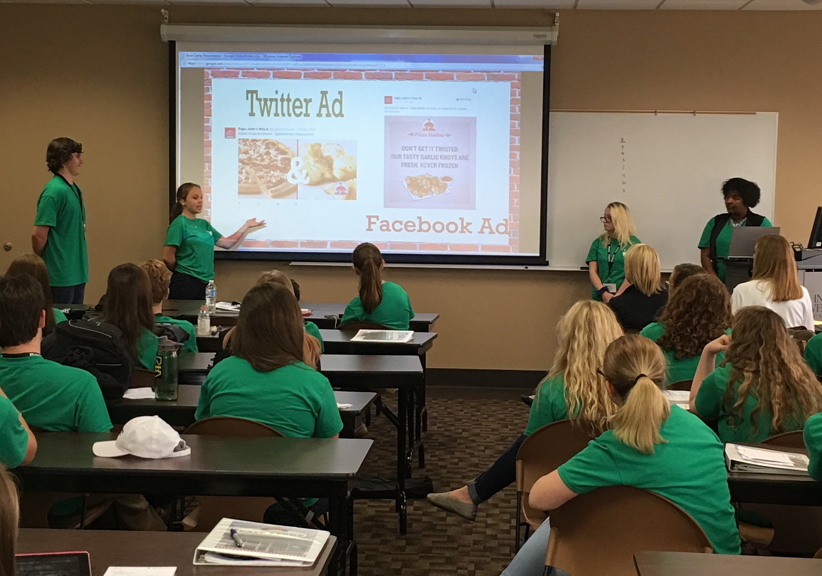

Slide 108
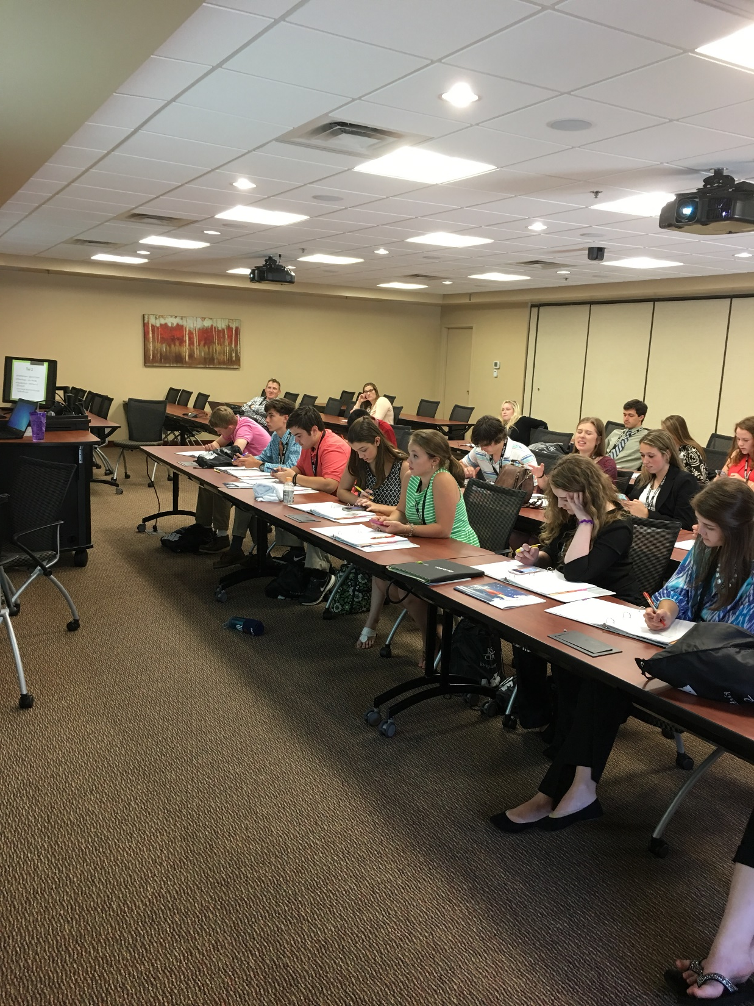

Slide 109
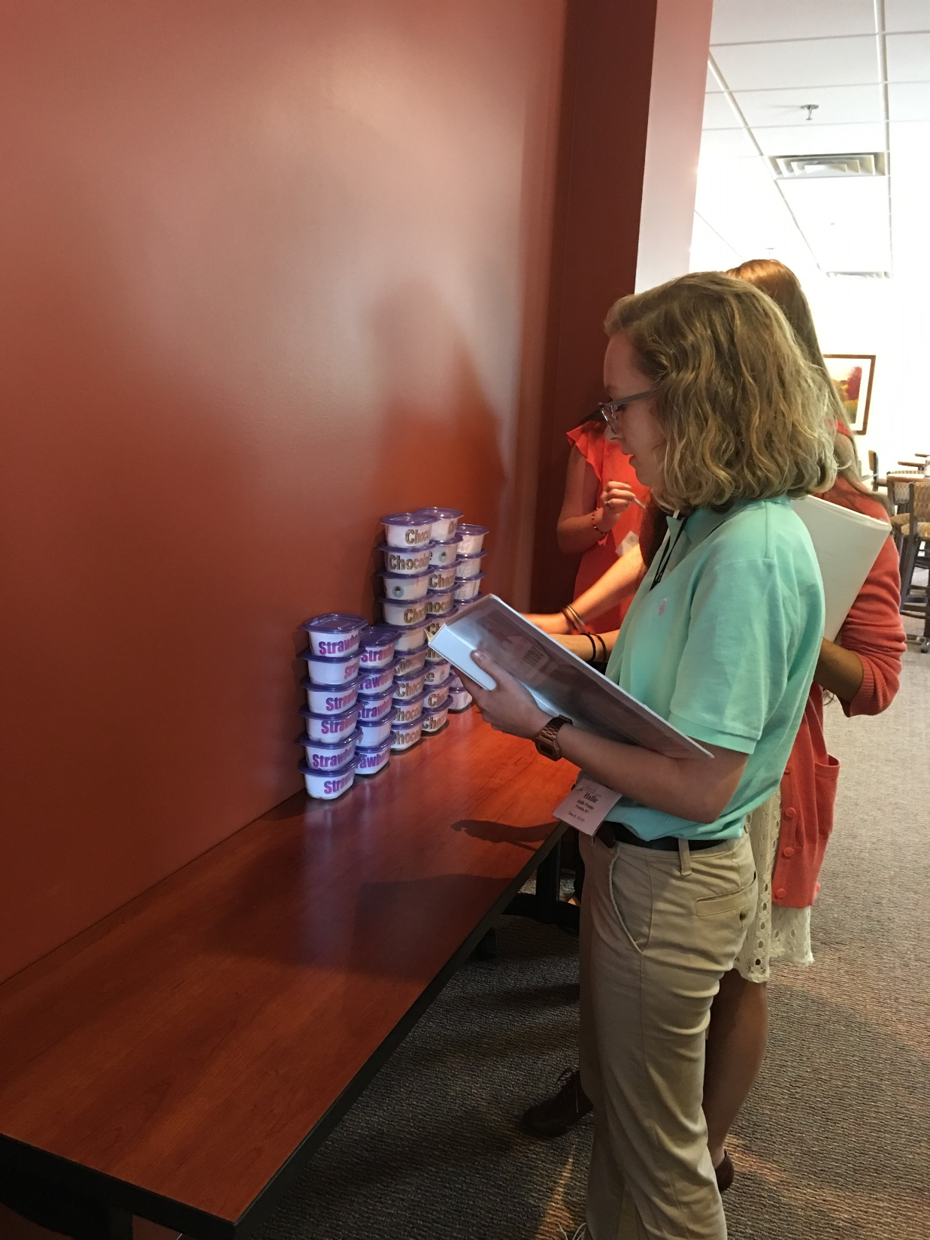

Slide 110
Questions?

