Slide 1

KACTE Conference
Louisville, KY
July 24 & 25, 2017
Speaker: Terry Brown
Topic: Saving our Future Generations

Slide 2
Agenda
Introduction
Discussion of today’s financial challenges – in particular, retirement planning
Presentation of relevant teaching tools for today’s youth

Slide 3
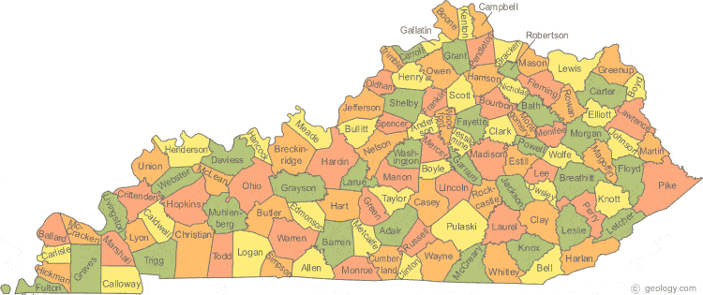
Started my life here in 1964
Webster County

Slide 4

Spent much time here growing up

Slide 5
So why am I here today?

Slide 6
So why am I here today?
I was spooked by the economic collapse in 2008

Slide 7
So why am I here today?
I was spooked by the economic collapse in 2008
I have strong concerns about the future of our youth’s
financial security

Slide 8
So why am I here today?
I was spooked by the economic collapse in 2008
I have strong concerns about the future of our youth’s
financial security
I believe in the power of SIMPLICITY…….and I love
helping people

Slide 9


Slide 10
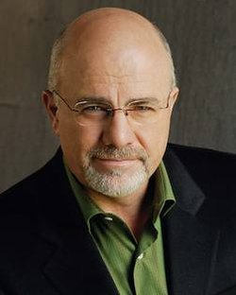
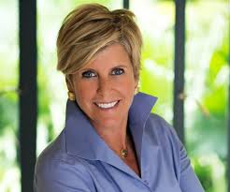
Who I am not……………..
Dave Ramsey
Suze Orman
One who will advise you to brownbag your lunch
until you retire

Slide 11
Who I am ……………..
A practical person who values simplicity
One who believes life is not a business
A realist who is also an optimist

Slide 12
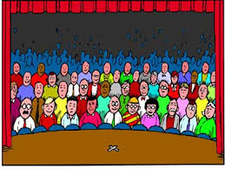
Who is my audience??

Slide 13





It’s the guy swimming from the shark
A
B
C
A – The top 2% of population; spoon fed group who doesn’t feel financial pain
B – The group that is “under water” financially; cries out for help……sometimes faces bankruptcy
C – The silent majority who lives paycheck to paycheck, fending off the sharks

Slide 14
This is the “80% of America” group:
- working class
- typically pays taxes
- has goal of a good retirement

Slide 15

My list of top concerns for today’s youth
Intergenerational spending trends
Automobiles
Credit cards
Retirement plans

Slide 16

Intergenerational spending trends

Slide 17




Intergenerational spending trends
In 1970, a land line phone was a want; today it is a need
(perhaps)…………………… combined with internet service,
cell phone, and data plans
As years have passed……

Slide 18
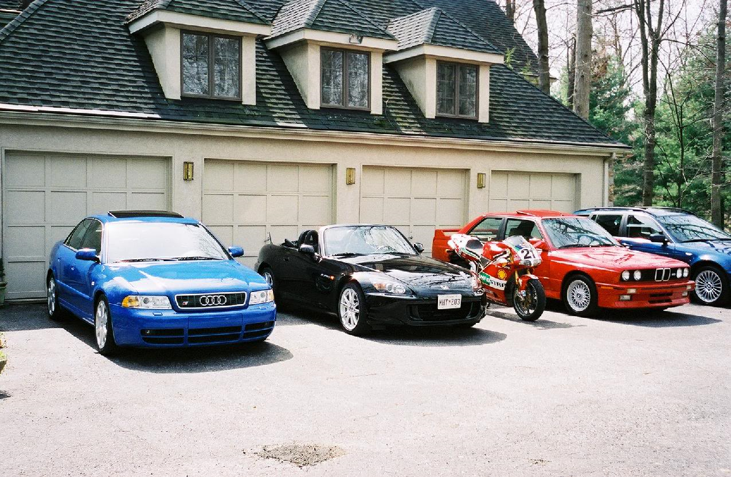
Intergenerational spending trends

Slide 19
Intergenerational spending trends
As a society’s standard of living increases, former “wants” become added to the growing list of “needs”
If we don’t manage the costs well, the result can be financial stress………..regardless of income level

Slide 20
This respected economist says it best
…………. In the year before the recession of 2009 it was asserted that the average worker had less than 72 hours of float – they would need to get a job within that period if they wanted to maintain their lifestyle. Today that float is not much better – no more than a week.
Source: Business Intelligence Brief (May 26, 2016)

Slide 21
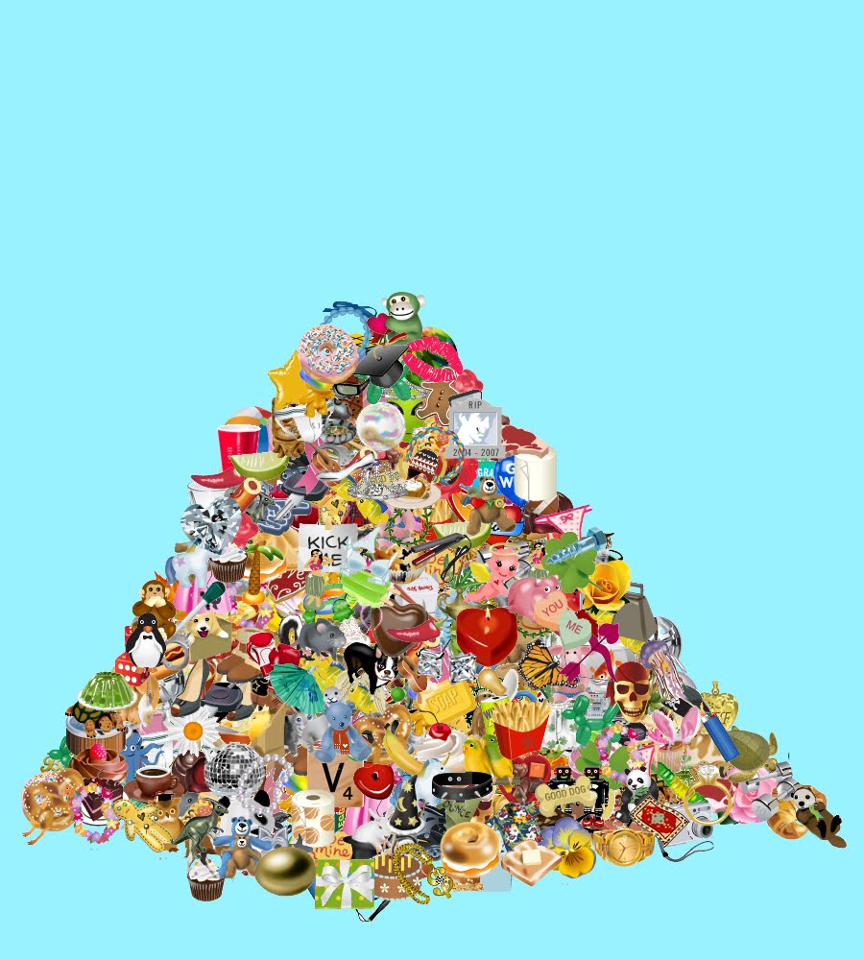
Financial reality today
Mound of wants

Slide 22

Automobiles (Money on Wheels)

Slide 23
Automobiles
The realist in me will not suggest that cars must be purchased with cash
(unlike Mr. Ramsey).
The realist in me also will not allow myself to recommend what level of
extravagance you choose. We all have different tastes.
The optimist in me, however, will advise at least a 50% down payment
The optimist in me further suggests that credit terms be three years or less

Slide 24
Automobiles
Unlike houses and land, cars unfortunately depreciate quickly
We actually consume the use of a car over time (much like a
refrigerator, lawn mower, renting a condo)
The financial issue is not necessarily what car we buy, but HOW
WE MANAGE THE CONSUMPTION OF SUCH OVER TIME

Slide 25

Automobiles
Regardless of how much we love “Betsy”, what we drive is eventually headed here

Slide 26

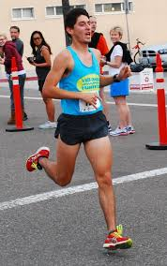

Automobiles
Which owner are you?
The marathon runner = keeps 8+ years
The 5-mile runner = keeps 4-8 years
The 100-yard sprinter = keeps < 4 years

Slide 27
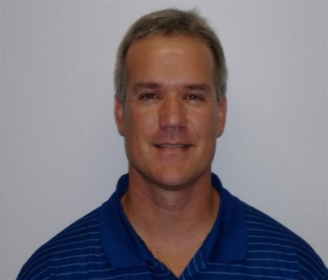
Automobiles
Let’s use third grade math
Count # of vehicles bought, then subtract one => 8 – 1 = 7
Calculate number of years since adulthood => 51 – 21 = 30
Divide #2 result by #1 result => 30 / 7 = 4.3
If married, multiply #3 result by 2 => 4.3 x 2 = 8.6
(If single, use #3 result)

Slide 28
Automobiles
Two things that drive me nuts……………………

Slide 29
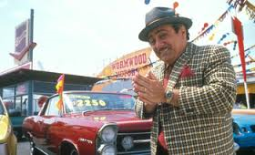
Automobiles
Two things that drive me nuts……………………
Answering the question “what kind of payment are you looking at”?

Slide 30
Automobiles
Two things that drive me nuts……………………
Answering the question “what kind of payment are you looking at”?
2. Hearing “My car will be paid off in two months……….I’ve started looking around for a new one”

Slide 31

Credit cards

Slide 32
Credit cards
Over the past thirty years credit cards have dramatically
changed how we live:
Convenience of payments (gas, groceries, insurance,
doctor visits)
Purchases over the Internet
Ease of foreign travel

Slide 33
Credit cards
There are three groups of users:

Slide 34
Credit cards
There are three groups of users:
One who pays off entire balance monthly

Slide 35
Credit cards
There are three groups of users:
One who pays off entire balance monthly
One who regularly makes a payment each month

Slide 36
Credit cards
There are three groups of users:
One who pays off entire balance monthly
One who regularly makes a payment each month
One who gets the card, loads up on purchases, and
pays minimum due each month, at best

Slide 37
Credit cards
Group 1: Pays off full balance
Advantages:
Free one-month financing
Receives user rebates (often 1+% of purchases)
Establishes good credit rating
Disadvantages:
The “ease of the swipe” can be tempting to spend more

Slide 38
Credit cards
Group 3: Never pays off balance
Advantages:
Can be a source of instant high-level spending
Disadvantages:
The “ease of the swipe” can be tempting to spend more
Walking away from the debt can destroy credit rating
Constant haggling with collection agencies

Slide 39
Credit cards
Group 2: Always makes a payment
Advantages:
Receives user rebates (often 1+% of purchases)
Establishes good credit rating (because you always pay)
Disadvantages:
The “ease of the swipe” can be tempting to spend more
Get lulled into a “comfort zone” of carrying high-interest debt
One loses motivation to pay down the debt
Becomes a permanent high rate debt

Slide 40
Credit cards
Group 1 and sometimes Group 3 users profit
from the credit card company
Group 2 users fund the party by:
A. helping to pay the Group 1 rebates
B. helping cover collection losses from Group 3
C. paying 18% interest on permanent loans

Slide 41

Credit cards
Does a 17.5% return on investment sound
too good to be true?

Slide 42
Credit cards
Does a 17.5% return on investment sound
too good to be true?
Answer: Not for a Group 2 credit card user

Slide 43

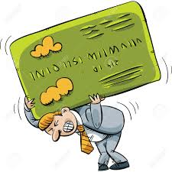
Credit cards
Assets
Liabilities
$ 2,000 balance
$ 5,000 balance
+ 0.5%
- 18.0%
$ 3,000 balance
+ 0.5%

Slide 44
Credit cards
What if we paid off the $5,000 credit card balance?
Loss of annual interest income from bank $ 25
Reduced interest expense from credit card 900
Equals: Increase in wealth (a 17.5 % return) $ 875

Slide 45


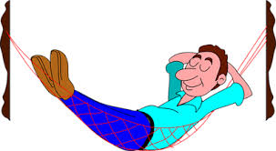

Credit cards
We get too obsessed looking for the newest stock tip
to invest our extra money
We want to be an “active” investor (investing in assets)
Group 2 users should first look to be “passive” investors
(paying down debt)
A guaranteed 17.5% return is too foolish to turn down

Slide 46
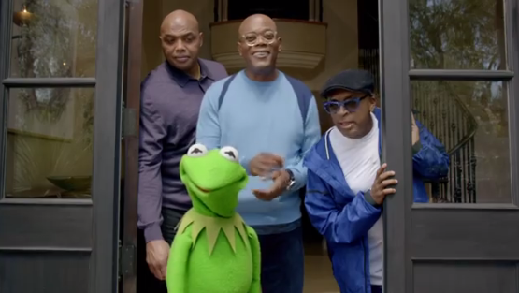
Who’s paying for this commercial???
Group 2 folks fund the party by paying the 18%

Slide 47

Retirement Plans

Slide 48
Retirement Plans
In the early 80’s, the 401(k) plan was first introduced
In large companies, employees were often provided defined benefit
plans + the 401(k). The mid to late 80’s were the heydays
In recent years, companies have abandoned the traditional pensions
altogether in favor of having only the 401(k)………………..WHY???

Slide 49
Retirement Plans
In the early 80’s, the 401(k) plan was first introduced
In large companies, employees were often provided defined benefit
plans + the 401(k). The mid to late 80’s were the heydays
In recent years, companies have abandoned the traditional pensions
altogether in favor of having only the 401(k)………………..WHY???
Because pensions guarantee future benefits (costly; uncertain)

Slide 50
Retirement Plans
In the early 80’s, the 401(k) plan was first introduced
In large companies, employees were often provided defined benefit
plans + the 401(k). The mid to late 80’s were the heydays
In recent years, companies have abandoned the traditional pensions
altogether in favor of having only the 401(k)………………..WHY???
Because pensions guarantee future benefits (costly; uncertain)
401(k) only commits to current funding (cheaper; costs are certain)

Slide 51

Retirement Plans
Even Kentucky state pensions are coming under scrutiny today
This trend will not be slowing down

Slide 52
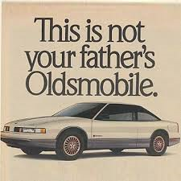
Retirement Plans

Slide 53
Retirement Plans
Neither is it his pension…….we are living in a different world

Slide 54
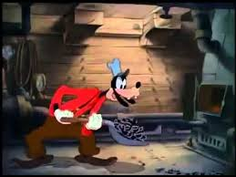

Retirement Plans
Today’s needs, wants, toys

Slide 55
Retirement Plans
Today’s needs, wants, toys
The best of times in the mid to late 80’s

Slide 56
Retirement Plans
Today’s needs, wants, toys
Tomorrow’sneeds, wants, toys
Today we must feed
both furnaces

Slide 57
Today’s reality for retirement
If we don’t play the 401(k) game……………

Slide 58
Today’s reality for retirement
If we don’t play the 401(k) game……………
Our employer doesn’t play……….

Slide 59
Today’s reality for retirement
If we don’t play the 401(k) game……………
The employer doesn’t play……….
and the employer doesn’t PAY

Slide 60
Today’s reality for retirement
If we don’t play the 401(k) game……………
Our employer doesn’t play……….
and the employer doesn’t PAY
This scenario threatens to cripple the future
of our country

Slide 61
Anecdotal evidence
Already seeing workers at our plant in mid 60’s saying they’re not “ready” to retire
Physically, they are ready……….. Financially, they are not
And these are the “good” generation of savers

Slide 62
What must be educated to our Youth?

Slide 63
What must be educated to our Youth?
Show the power of compounding

Slide 64
What must be educated to our Youth?
Show the power of compounding
Maximize the 401(k) match

Slide 65
What must be educated to our Youth?
Show the power of compounding
Maximize the 401(k) match
Starting at Day 1

Slide 66
What must be educated to our Youth?
Show the power of compounding
Maximize the 401(k) match
Starting at Day 1
To wait is toxic

Slide 67
Retirement Plans
Assume one starts work at age 21 and plans to work though age 69
Employer has just the 401(k) plan
Employer matches dollar for dollar up through 5%
Assume beginning salary of $ 50,000
Assume the average rate of return is 8%

Slide 68

Retirement Plans
Let’s make this real life……………………………………..

Slide 69

Retirement Plans
At retirement, the accumulated balance would grow to $ 2.45 million

Slide 70
Retirement Plans
At retirement, the accumulated balance would grow to $ 2.45 million
However, I didn’t allow for inflation or job promotions
If we use a 2% inflation factor (with no job promotions)…….

Slide 71

Retirement Plans
The balance would now be $ 3.40 million at retirement!!!
Using a conservative 8% return

Slide 72
Retirement Plans
Earnings make up 88% of the balance
Employee has less than 6% of his own money invested

Slide 73
Retirement Plans
Just for fun, what if the investment rate was 12%...............

Slide 74
Retirement Plans
Just for fun, what if the investment rate was 12%...............
Payout would be $ 12. 8 million!!

Slide 75
Retirement Plans
Earnings make up over 97% of the balance
Employee has less than 2% of his own money invested

Slide 76
Personal experience with 401(k) performance

Slide 77
Personal experience with 401(k) performance
Rule of 72

Slide 78
Personal experience with 401(k) performance
Rule of 72
Investment today will double every 6 yrs

Slide 79
Personal experience with 401(k) performance
Rule of 72
Investment today will double every 6 yrs
$1,000 today will equal $64,000 in 36 yrs

Slide 80
1. Retirement Plans (waiting impact)
Now for the sobering facts…………………….
What if Savannah waits until age 31 to set money aside

Slide 81
1. Retirement Plans (waiting impact)
Now for the sobering facts…………………….
What if Savannah waits until age 31 to set money aside
$ 1.50 million payout (decrease of 56%)

Slide 82
1. Retirement Plans (waiting impact)
Or she waits until age 41 to set money aside

Slide 83
1. Retirement Plans (waiting impact)
Or she waits until age 41 to set money aside
$ 0.63 million payout (decrease of 81%)

Slide 84
1. Retirement Plans (waiting impact)
Or she waits until age 51 to set money aside

Slide 85
1. Retirement Plans (waiting impact)
Or she waits until age 51 to set money aside
$ 0.24 million payout (decrease of 93%)

Slide 86
1. Retirement Plans (waiting impact)
10% own money
15% own money
24% own money

Slide 87

2. Retirement Plans (choice of % impact)
Would anyone ever refuse a 4% pay raise?

Slide 88

2. Retirement Plans (choice of % impact)
Would anyone ever refuse a 4% pay raise?
People do it all the time

Slide 89
2. Retirement Plans (choice of % impact)
At age 21, what if Savannah chooses to set aside 1% of pay,
instead of the 5% maximum?
Stated another way, what if she refuses a 4% raise?

Slide 90

2. Retirement Plans (choice of % impact)
A $ 0.7 million retirement instead of the $ 3.4 million from using the 5% maximum match
$ 0.7 M
$ 3.4 M

Slide 91
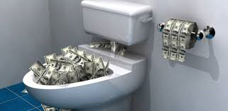
2. Retirement Plans (choice of % impact)
Employer 4% match
never taken, or
$ 164,000
Future earnings on the 4% match + 4% employee part, or
$ 2,390,000
The “real” price paid for not investing the additional 4%
of own money over one’s working career

Slide 92
2. Retirement Plans (choice of % impact)
So why the apparent “ignorance”?

Slide 93
2. Retirement Plans (choice of % impact)
So why the apparent “ignorance”?
We want as much of our paycheck as we can get now

Slide 94
2. Retirement Plans (choice of % impact)
So why the apparent “ignorance”?
We want as much of our paycheck as we can get now
We think everything will be OK at retirement as long
as we are contributing a little something

Slide 95
2. Retirement Plans (choice of % impact)
So why the apparent “ignorance”?
We want as much of our paycheck as we can get now
We think everything will be OK at retirement as long
as we are contributing a little something
We think our pension today is like our parents and grandparents

Slide 96
Let’s digress a moment………..

Slide 97
My list of top concerns for today’s youth?
Intergenerational spending trends
Automobiles
Credit cards
Retirement plans

Slide 98
Why the distinction between yellow and red?
Intergenerational spending trends – current issue
Automobiles – current issue
Credit cards – current issue
Retirement plans – future issue

Slide 99

Retirement Plans
When we get “feedback” from our jeans, we tend to move into action
If current issues give us financial discomfort, we may act to change

Slide 100
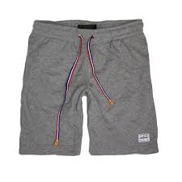
Retirement Plans

Slide 101
Retirement Plans
We have difficulty grasping future retirement concerns, so we ignore
and enjoy the flexible waistband of the sweats
We put this part of our life on financial cruise….. we stay comfortable

Slide 102
Retirement Plans
So why do we have trouble grasping future retirement concerns???

Slide 103
Retirement Plans
So why do we have trouble grasping future retirement concerns???
We are dealing with the future (or uncertainty)

Slide 104
Retirement Plans
So why do we have trouble grasping future retirement concerns???
We are dealing with the future (or uncertainty)
Don’t know how much money we will need

Slide 105
Retirement Plans
So why do we have trouble grasping future retirement concerns???
We are dealing with the future (or uncertainty)
Don’t know how much money we will need
Don’t know how long we have to live

Slide 106
Retirement Plans
So why do we have trouble grasping future retirement concerns???
We are dealing with the future (or uncertainty)
Don’t know how much money we will need
Don’t know how long we have to live
We do not take the time to estimate where we currently stand

Slide 107

Retirement Plans
So what can a person do to better prepare for retirement?

Slide 108
Retirement Plans
So what can a person do to better prepare for retirement?
Start the 401(k) as soon as possible

Slide 109
Retirement Plans
So what can a person do to better prepare for retirement?
Start the 401(k) as soon as possible
Maximize the match

Slide 110
Retirement Plans
So what can a person do to better prepare for retirement?
Start the 401(k) as soon as possible
Maximize the match
Weigh yourself financially each quarter

Slide 111
Retirement Plans
So what can a person do to better prepare for retirement?
Start the 401(k) as soon as possible
Maximize the match
Weigh yourself financially each quarter
In order to know where we wish to be, we must
first know where we are

Slide 112
Retirement Plans
Net worth = Assets you own minus Debt you owe
Try this exercise…………………….you will be surprised

Slide 113

Retirement Plans
Weigh your net worth quarterly for
financial feedback
This will keep you engaged with your
long-term financial goals
Avoid financial cruise control

Slide 114


Retirement Plans
Or else……………………………………..
My heartfelt concern is when our younger generation considers retirement,
they will find out they have no hope of enjoying a comfortable life after
leaving the work force. Sadly, it will then be too late.

Slide 115
What we must teach our youth

Slide 116
What we must teach our youth
Don’t just preach “save, save, save………..”

Slide 117
What we must teach our youth
Don’t just preach “save, save, save………..”
Must explain “why” times are different today (true
pension vs. 401(k) plan)

Slide 118
What we must teach our youth
Don’t just preach “save, save, save………..”
Must explain “why” times are different today (true
pension vs. 401(k) plan)
Stress that the 401(k) is probably going to be
the only life raft out there

Slide 119

Investments & Insurance – early stage of career
Retirement savings
Need for life insurance

Slide 120

Investments & Insurance – healthy retirement
Need for life insurance
Retirement savings

Slide 121
Investments & Insurance – worst case at retirement
Retirement savings
Need for life insurance
Need for life insurance
Retirement savings

Slide 122
My approach to Finance education
Demonstrate the power of compounding

Slide 123
My approach to Finance education
Demonstrate the power of compounding
Stress the concept of sacrificing now for more later

Slide 124
My approach to Finance education
Demonstrate the power of compounding
Stress the concept of sacrificing now for more later
Give students simple tools to evaluate situations

Slide 125
My approach to Finance education
Demonstrate the power of compounding
Stress the concept of sacrificing now for more later
Give students simple tools to evaluate situations
Be realistic with our message

Slide 126
Summary of teaching materials
“Fields of Green” book
Twenty chapter book
140 pages

Slide 127
Summary of teaching materials
150 Powerpoint slides that summarize each of 20 chapters
Other topics:
Needs vs. Wants
What is Net Worth?
Investments vs. Insurance
Term vs. Whole Life Insurance
College Funding
Purchasing a Home
Don’t Fall in Love with These Two Things
Texting Behind Home Plate

Slide 128

Summary of teaching materials
5 EXCEL files
Mortgage payments
Car payments
Car consumption costs (4 yr vs. 8 yr)
Retirement – waiting too late
Retirement – not maxing the match

Slide 129


Slide 130
Mortgages – 15 yr vs. 30 year financing – one input worksheet

Slide 131
Mortgages – 15 yr vs. 30 year financing – table of results

Slide 132
Mortgages – 15 yr vs. 30 year financing – debt schedule

Slide 133
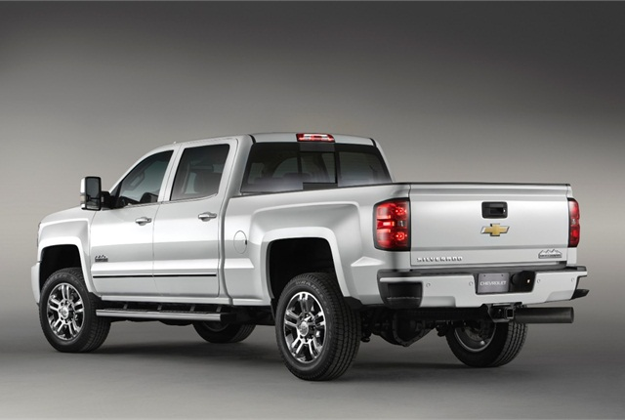

Slide 134
Car financing – one input worksheet

Slide 135
Car financing – table of results

Slide 136
Car financing – debt schedules

Slide 137
Car Consumption Costs – one input worksheet (50 yr example)
NOTE: Does not include property tax and insurance cost differences, or financing costs

Slide 138
Car Consumption Costs – table of results

Slide 139
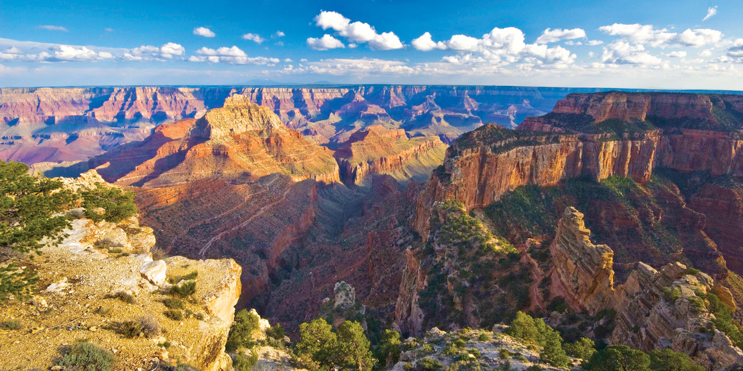

Slide 140
Retirement Funding – waiting too late (one input)

Slide 141
Retirement Funding – waiting too late (summary)

Slide 142
Retirement Funding – waiting too late (graphs)

Slide 143
Retirement Funding – not maxing the match (one input)

Slide 144
Retirement Funding – not maxing the match (summary)

Slide 145
Retirement Funding – not maxing the match (summary)

Slide 146
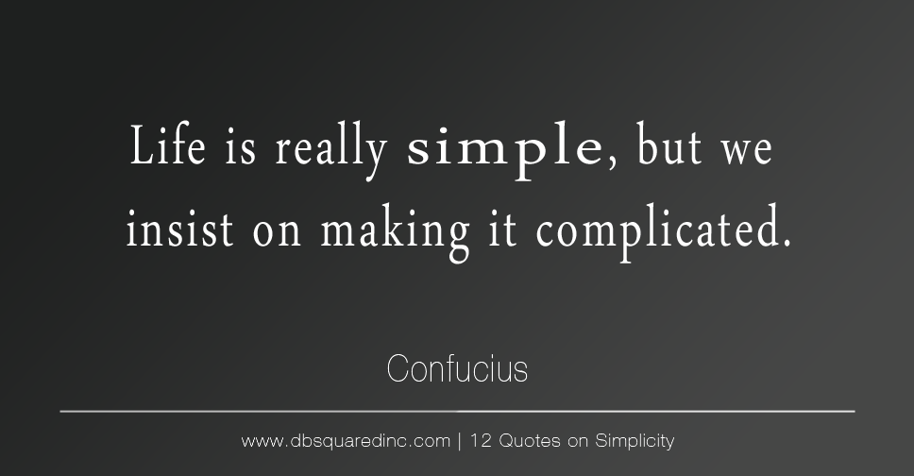

Slide 147
Chapter 20 – I Think I’m Done
Questions?

Slide 148

There is a reason accountants
aren’t in advertising…………
MAX

